Slide 1

DEEP NEURAL NETWORK MODULE # 4 : LINEAR NEURAL NETWORKS FOR CLASSIFICATION
DNN Team
BITS Pilani WILP

Slide 2
The instructor is gratefully acknowledging the authors who made their course materials freely available online.
This deck is prepared by Seetha Parameswaran.
Deep Learning
2 / 100

Slide 3





Table of Contents
1
Classification
Binary Classification
Logistic Regression
The Model: Single Neuron for Binary Classification
Binary Classification: Worked Example
Binary Classification: Evaluation Metrics
Multi-class Classification
Multi-class Classification Model
Mini-batch Stochastic Gradient Descent
Multiclass Classification: Worked Example
Making Predictions (Inference)
Multiclass Classification: Evaluation Metrics
Implementation Tips and Debugging
Summary
2
3
4
5
Deep Learning
3 / 100

Slide 4
Stochastic Gradient Descent (SGD)
Key Idea:
Instead of computing gradient over entire dataset, use gradient from a single ran- dom example.
SGD Update Rule: At iteration t :
Randomly select one example (x^{(i)}, y ^{(i)})
Compute gradient for this example: ∇l(w; x^{(i)}, y ^{(i)}) (noisy gradient estimate) Update weights: w^{(t +1)} = w^{(t )} − η∇l(w^{(t )}; x^{(i)}, y ^{(i)})
1
2
3
The noise in SGD actually helps escape local minima and often leads to better gen- eralization!
Deep Learning
Notes:
Stochastic Gradient Descent (SGD) is an optimization algorithm that iteratively updates model parameters to minimize a loss function, similar to traditional gradient descent but using a single training example or a small batch to compute the gradient at each step. This approach makes SGD computationally efficient and faster for large datasets, as it avoids the cost of processing the entire dataset at once
In Batch Gradient Descent, we compute the gradient using all training examples before making one update. In SGD, we don’t wait for the whole dataset. Instead, we: pick one random example $\left(x^{\left(i\right)} , y^{\left(i\right)}\right)$
compute gradient using only that example
update weights immediately
Update rule (point to the formula):
$w^{\left(t+1\right)}=w^{\left(t\right)}−η∇ℓ\left(w^{\left(t\right)} ; x^{\left(i\right)} ; y^{\left(i\right)}\right)$
$η$= learning rate
$∇ℓ\left(⋅\right)$= gradient of loss for that one example

Slide 5
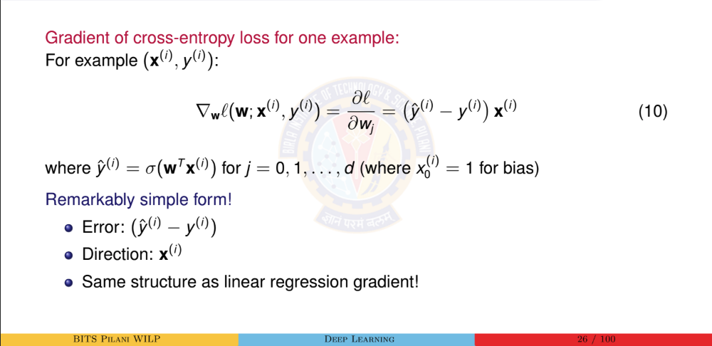
Computing the Gradient for SGD

Slide 6
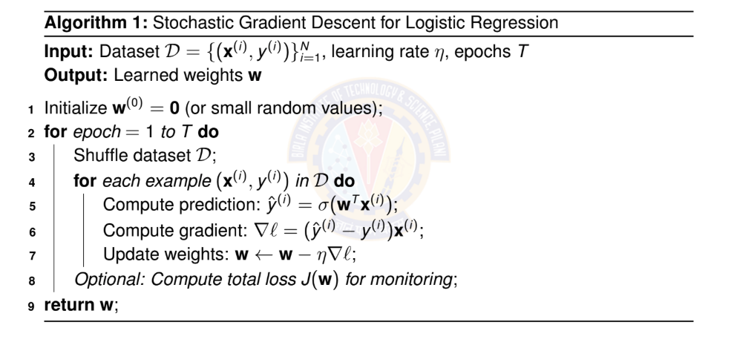
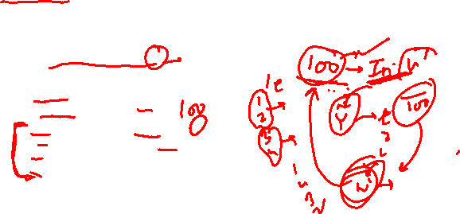
Stochastic Gradient Descent Algorithm
Algorithm 1: Stochastic Gradient Descent for Logistic Regression
Input: Dataset D = {(x^{(i)}, y ^{(i)})}^{N} , learning rate η, epochs T
i=1
Output: Learned weights w
1 Initialize w⁽⁰⁾ = 0 (or small random values);
2 for epoch = 1 to T do
Shuffle dataset D;
for each example (x^{(i)}, y ^{(i)}) in D do
3
4
5
6
7
8
Compute prediction: y^{ˆ(i)} = σ(w^{T} x^{(i)});
Compute gradient: ∇l = (y^{ˆ(i)} − y ^{(i)})x^{(i)}; Update weights: w ← w − η∇l;
Optional: Compute total loss J(w) for monitoring;
9 return w;
Deep Learning
Notes:
For one example $\left(x^{\left(i\right)} , y^{\left(i\right)}\right)$,
$∇_{w}ℓ\left(w ; x^{\left(i\right)} ; y^{\left(i\right)}\right)=\left({\hat{y}}^{\left(i\right)}−y^{\left(i\right)}\right) x^{\left(i\right)}$
This is exactly the equation shown: gradient = (prediction − true label) × input.
Initialize $w^{\left(0\right)}$(often zeros or small random)
Repeat for epochs $1..T$:
Shuffle dataset $D$(important so we don’t learn in a fixed order).
For each example $\left(x^{\left(i\right)} , y^{\left(i\right)}\right)$:
compute prediction: ${\hat{y}}^{\left(i\right)}=σ\left(w^{T}x^{\left(i\right)}\right)$
compute gradient: $\left({\hat{y}}^{\left(i\right)}−y^{\left(i\right)}\right)x^{\left(i\right)}$
update: $w←w−η∇ℓ$
Define two words clearly (students always ask):
Iteration = one weight update (one example processed)
Epoch = one full pass over the whole dataset (after shuffling)
And prediction is:
${\hat{y}}^{\left(i\right)}=σ\left(w^{T}x^{\left(i\right)}\right)$
(where $σ$is sigmoid; and bias is handled with $x_{0}^{\left(i\right)}=1$).
Error term: $\left({\hat{y}}^{\left(i\right)}−y^{\left(i\right)}\right)$Direction term: $x^{\left(i\right)}$“Same structure as linear regression gradient” (because in both cases gradient is error × input).
Iteration = one weight update (one example processed)
Epoch = one full pass over the whole dataset (after shuffling)

Slide 7

SGD vs Batch GD: Visual Comparison
w₂
Batch GD
SGD
Batch GD: Smooth, deter- ministic path
SGD: Noisy, stochastic path but faster iterations
w₁
_{w}∗
Deep Learning
Notes:
Batch gradient descent is an optimization algorithm that calculates the gradient using the entire training dataset to update a model's parameters in each iteration. This approach provides a stable and accurate gradient but can be slow and memory-intensive for very large datasets. It is well-suited for smaller datasets or convex error surfaces where stability is more important than speed.
Batch GD: smooth deterministic path
SGD: noisy zig-zag path but faster iterations
Batch GD uses the true average gradient, so it moves smoothly.
SGD uses a single-example gradient, so each step has randomness → zig-zag.
But each step is cheap (only one example), so you can do many updates quickly.

Slide 8
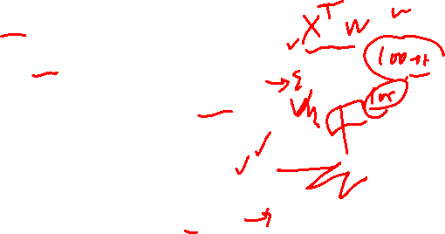
Benefits and Challenges of SGD
Benefits:
Speed: Much faster per iteration (only one example)
Memory: Can handle datasets that don’t fit in memory
Online learning: Can update model as new data arrives
Generalization: Noise helps escape sharp minima
Scalability: Works well with massive datasets
Challenges:
Noisy updates: Path to minimum is not smooth
Learning rate: More sensitive to η choice
Convergence: May oscillate near minimum
Hyperparameter tuning: Requires careful tuning
Common compromise: Mini-batch SGD
Deep Learning
Notes:
Benefits (how to explain):
Speed per iteration: one example only → very fast update.
Memory: doesn’t need whole dataset in RAM (can stream data).
Online learning: update as new data arrives (one-by-one processing).
Generalization: noise can help avoid getting stuck (slide explicitly states noise helps escape minima and improve generalization).
Scalability: works well when dataset is huge (because updates are cheap).
Challenges (how to explain):
Noisy updates: loss curve may jump up/down; path not smooth. (stochastic path shown).
Learning rate sensitivity: too large → unstable; too small → slow. (common practical note; also consistent with SGD settings discussion).
May oscillate near optimum: because noise keeps “kicking” you around. (matches “noisy path” and “not smooth”).
“Batch GD gives a stable direction but is expensive; SGD gives a noisy direction but is fast and scalable — and that noise is often a feature, not a bug.”

Slide 9




Table of Contents
Classification
Binary Classification
Logistic Regression
The Model: Single Neuron for Binary Classification
Binary Classification: Worked Example
Binary Classification: Evaluation Metrics
Multi-class Classification
Multi-class Classification Model
Mini-batch Stochastic Gradient Descent Multiclass Classification: Worked Example Making Predictions (Inference)
Multiclass Classification: Evaluation Metrics
Implementation Tips and Debugging
Summary
1
2
3
4
5
Deep Learning

Slide 10
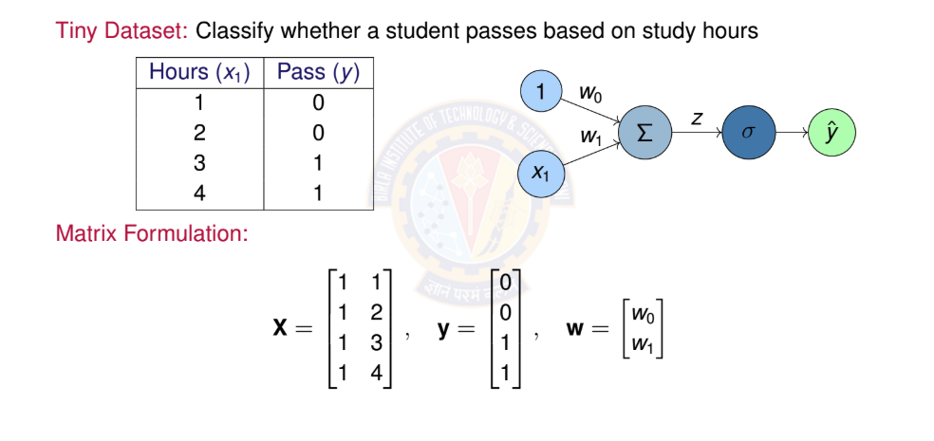
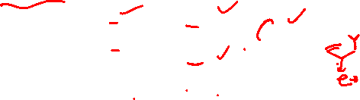
Numerical Example: Setup
Deep Learning

Slide 11
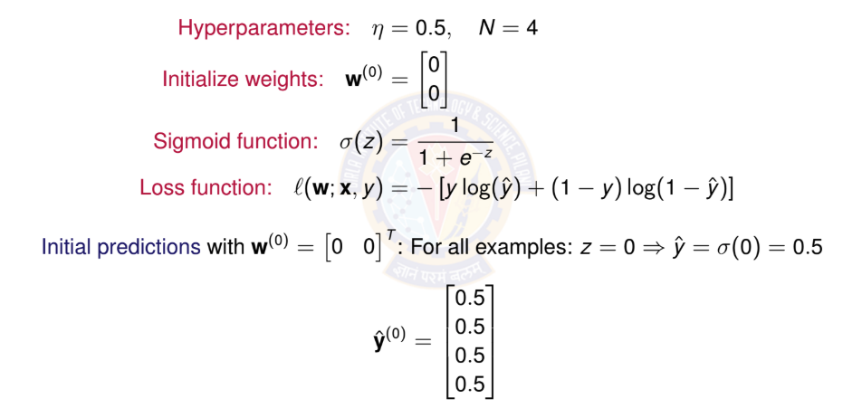
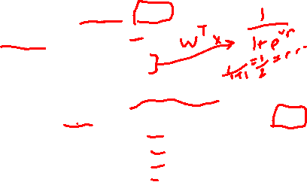
Numerical Example: Initialization
Deep Learning

Slide 12
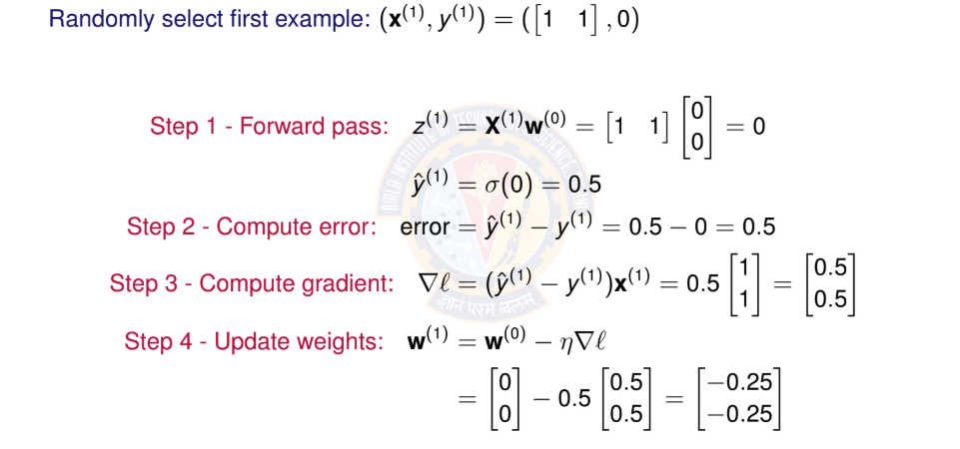
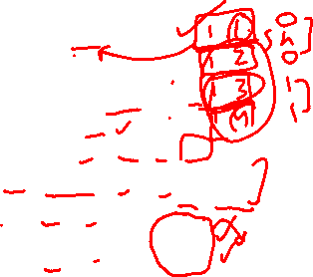
Numerical Example: First SGD Iteration
Deep Learning

Slide 13
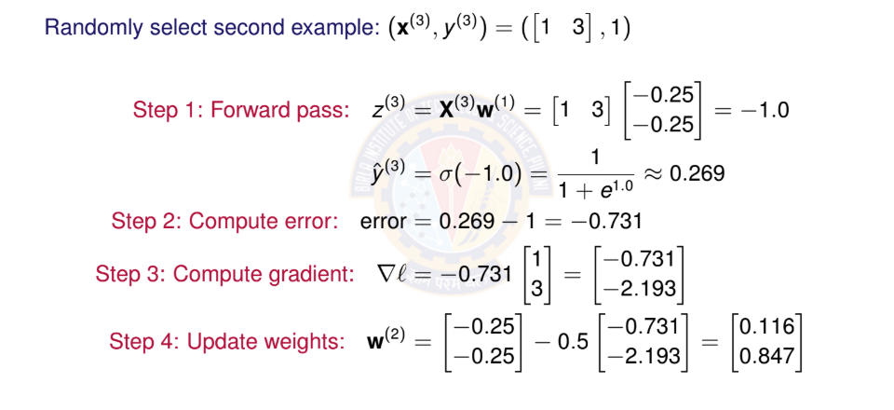
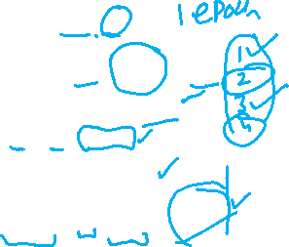
Numerical Example: Second SGD Iteration
Deep Learning

Slide 14
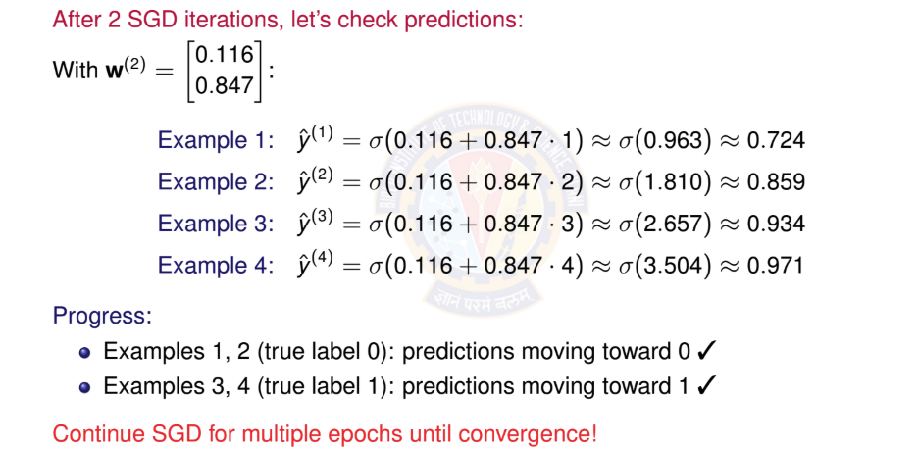
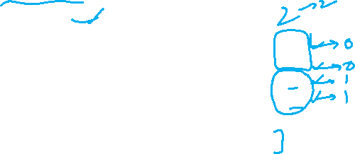
Numerical Example: Checking Progress
Deep Learning

Slide 15
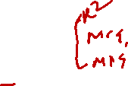
Table of Contents
Classification
Binary Classification
Logistic Regression
The Model: Single Neuron for Binary Classification
Binary Classification: Worked Example
Binary Classification: Evaluation Metrics
Multi-class Classification
Multi-class Classification Model
Mini-batch Stochastic Gradient Descent Multiclass Classification: Worked Example Making Predictions (Inference)
Multiclass Classification: Evaluation Metrics
Implementation Tips and Debugging
Summary
1
2
3
4
5
Deep Learning

Slide 16

Evaluating Classification Models
Unlike regression, we need different metrics for classification. Key Questions:
How often does the model predict correctly? (Accuracy) What types of errors does it make? (Confusion Matrix)
How well does it identify positive cases? (Precision, Recall)
Data Split:
Training set: Learn weights w (typically 90-99%) Validation set: Tune hyperparameters (typically 10-15%) Test set: Final evaluation (typically 1-10%)
Always evaluate on unseen test data to measure generalization!
Deep Learning

Slide 17

Confusion Matrix
The confusion matrix shows all prediction outcomes:
Predicted
 | Positive (1) | Negative (0)
Positive (1) | True Positive (TP) | False Negative (FN)
Negative (0) | False Positive (FP) | True Negative (TN)
Actual
Definitions:
TP: Correctly predicted positive TN: Correctly predicted negative
FP: Incorrectly predicted positive (Type I error) FN: Incorrectly predicted negative (Type II error)
Deep Learning

Slide 18

Classification Metrics I
1. Accuracy: Overall correctness
TP + TN
Accuracy =
(11)
TP + TN + FP + FN
2. Precision: Of predicted positives, how many are correct?
TP
Precision =
(12)
TP + FP
Deep Learning

Slide 19

Classification Metrics II
3. Recall (Sensitivity): Of actual positives, how many did we find?
TP
Recall =
(13)
TP + FN
4. F1 Score: Harmonic mean of precision and recall
_{F 1 = 2 ·} Precision × Recall
(14)
Precision + Recall
Deep Learning

Slide 20
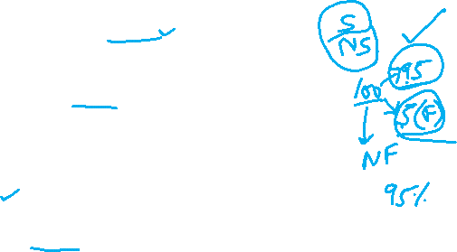
When to Use Which Metric?
Accuracy:
Use when classes are balanced
Misleading with imbalanced data! (e.g., 95% negative class)
Precision:
Important when False Positives are costly
Example: Spam detection (don’t want to mark real emails as spam)
Recall:
Important when False Negatives are costly
Example: Disease detection (don’t want to miss sick patients)
F1 Score:
Use when you need balance between precision and recall Good for imbalanced datasets
Deep Learning

Slide 21
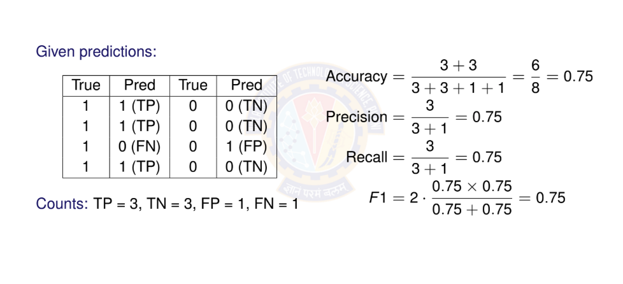

Example: Computing Metrics
Deep Learning

Slide 22
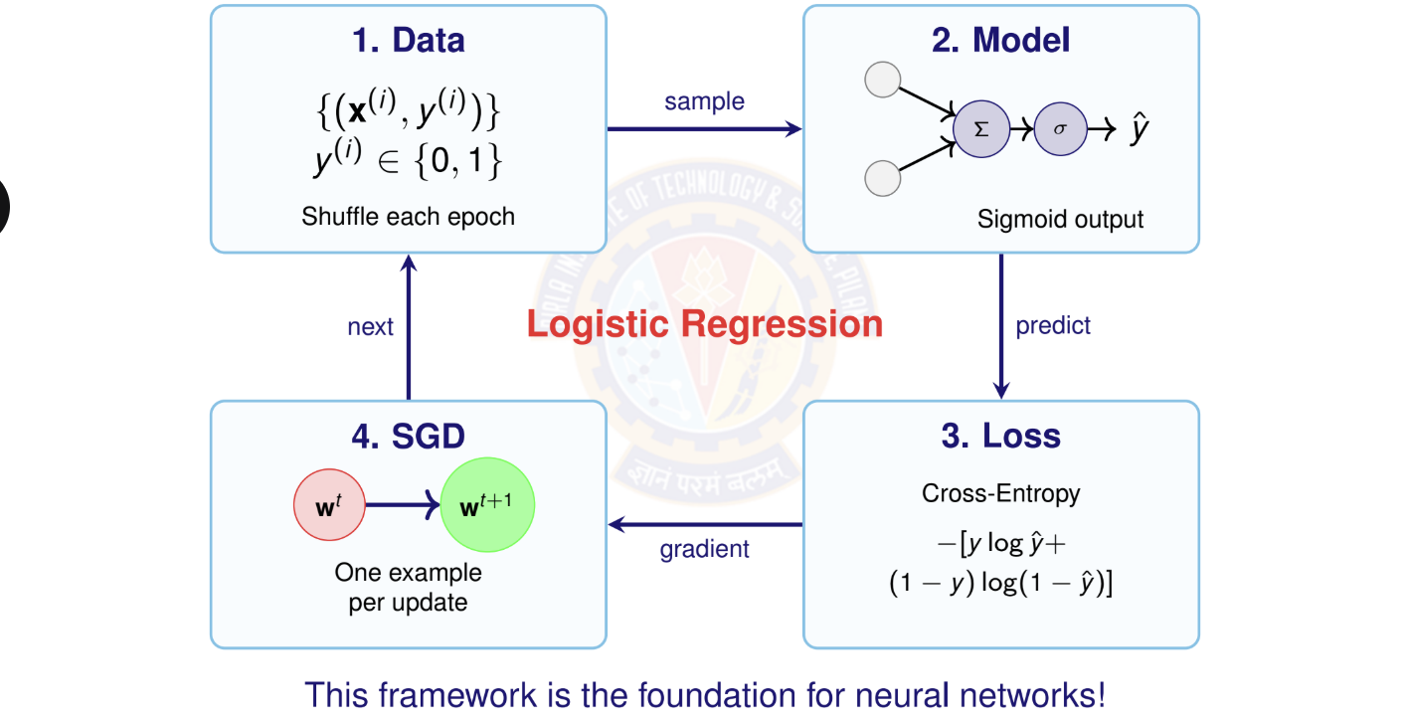
Summary: Binary Classification
Deep Learning

Slide 23
Key Takeaways
Binary classification predicts discrete categories using y ∈ {0, 1}.
Sigmoid activation σ(z) =
1
maps to probabilities [0, 1].
1+e
−z
Logistic regression = linear model + sigmoid activation.
Cross-entropy loss is the appropriate objective for classification.
Stochastic Gradient Descent (SGD) updates weights one example at a time — faster and more scalable.
Feature scaling is essential for convergence and numerical stability. Evaluation metrics: Accuracy, Precision, Recall, F1 Score, Confusion Matrix.
This framework extends naturally to multi-class classification and deep networks.
Deep Learning

Slide 24

Table of Contents
Classification
Binary Classification
Logistic Regression
The Model: Single Neuron for Binary Classification
Binary Classification: Worked Example
Binary Classification: Evaluation Metrics
Multi-class Classification
Multi-class Classification Model
Mini-batch Stochastic Gradient Descent
Multiclass Classification: Worked Example
Making Predictions (Inference)
Multiclass Classification: Evaluation Metrics
Implementation Tips and Debugging
Summary
1
2
3
4
5
Deep Learning

Slide 25
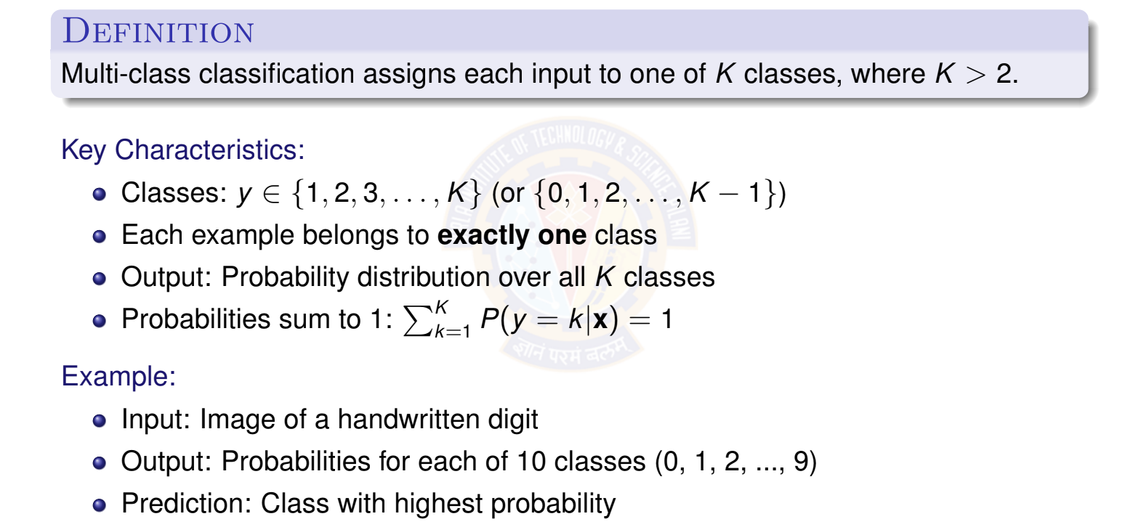
What is Multi-class Classification?
Deep Learning

Slide 26

Examples of Multi-class Classification
Handwritten Digit Recognition (MNIST)
Input: 28 × 28 pixel image
Output: One of 10 digits (0-9)
Image Classification (ImageNet)
Input: Color image
Output: One of 1000 object categories (cat, dog, car, plane, ...)
Text Classification
Input: News article text
Output: Topic category (politics, sports, technology, entertainment, business)
Speech Recognition
Input: Audio features
Output: Phoneme class (multiple phonemes in a language)
1
2
3
4
Deep Learning

Slide 27
Multi-class Classification: Visual Example
x₂
Class 1 Class 2
1
2
1
2
1
2
Key insight: We need
multiple output neu- rons (one per class) and a way to convert their outputs into a valid probability dis- tribution.
1
2
2
1
3
3
3
3
3
Class 3
x₁
Decision boundaries separate K = 3 classes in feature space.
Deep Learning

Slide 28
Table of Contents
Classification
Binary Classification
Logistic Regression
The Model: Single Neuron for Binary Classification
Binary Classification: Worked Example
Binary Classification: Evaluation Metrics
Multi-class Classification
Multi-class Classification Model
Mini-batch Stochastic Gradient Descent
Multiclass Classification: Worked Example
Making Predictions (Inference)
Multiclass Classification: Evaluation Metrics
Implementation Tips and Debugging
Summary
1
2
3
4
5
Deep Learning

Slide 29

The Four Components for Multi-class
A complete multi-class classification system consists of:
Data: Input features and class labels y ∈ {1, 2, . . . , K } Model: Linear model with K output neurons (no hidden layers) Activation: Softmax function to produce probability distribution Objective Function: Categorical cross-entropy loss
Learning Algorithm: Mini-batch stochastic gradient descent
1
2
3
4
5
Note: We now use mini-batch SGD instead of single-example SGD for better effi- ciency and stability.
Deep Learning
Notes:
Mini-batch stochastic gradient descent is an optimization algorithm that updates model parameters using small, random subsets of the training data called mini-batches. This method provides a balance between the computational cost of batch gradient descent and the high variance of pure stochastic gradient descent, making it efficient and stable for large datasets. It significantly reduces memory requirements compared to batch gradient descent and offers more stable convergence than stochastic gradient descent.

Slide 30
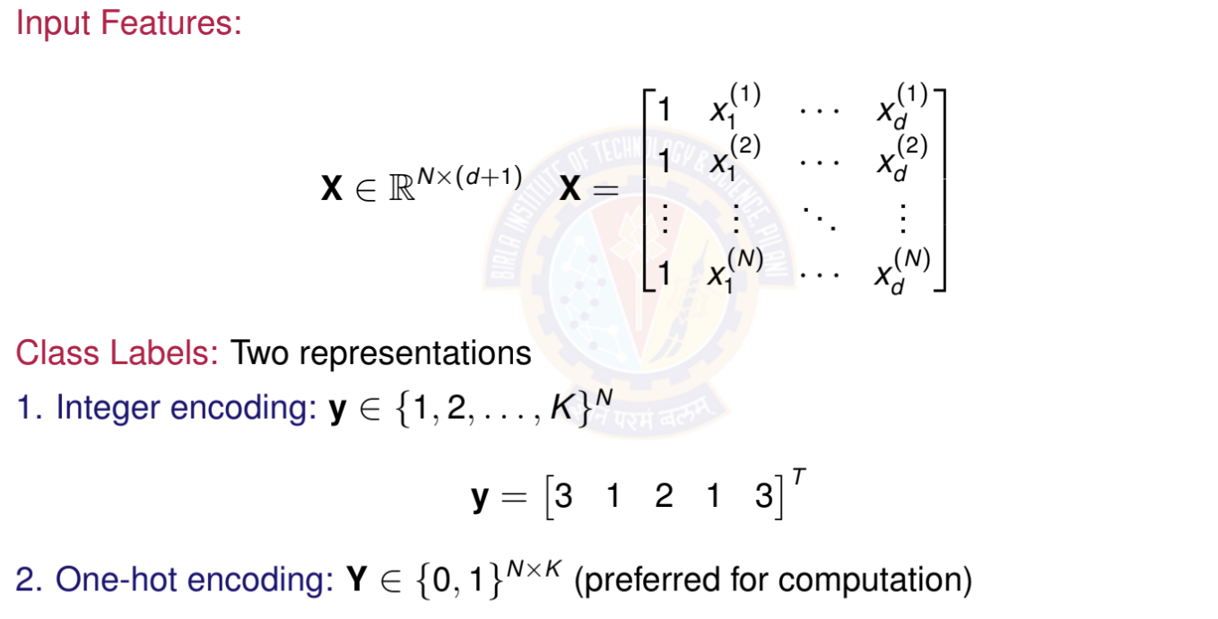
Data Representation
Deep Learning
Notes:
One-hot encoding is a process that converts categorical data into a numerical format that machine learning algorithms can process. It creates new binary (0 or 1) columns for each unique category in a given column, with a '1' indicating the presence of that category and a '0' indicating its absence. This is useful because it prevents algorithms from assuming an artificial order between categories that doesn’t exist.

Slide 31
One-Hot Encoding
Definition: Convert class label to binary vector of length K
For class k : All zeros except 1 at position k
Example with K = 4 classes:
Class 1: y = [1, 0, 0, 0]^{T}
Class 2: y = [0, 1, 0, 0]^{T}
Class 3: y = [0, 0, 1, 0]^{T}
Class 4: y = [0, 0, 0, 1]^{T}
Why one-hot?
Treats all classes equally (no implicit ordering) Matches the format of softmax output probabilities Simplifies loss computation
Standard in deep learning frameworks
Deep Learning

Slide 32
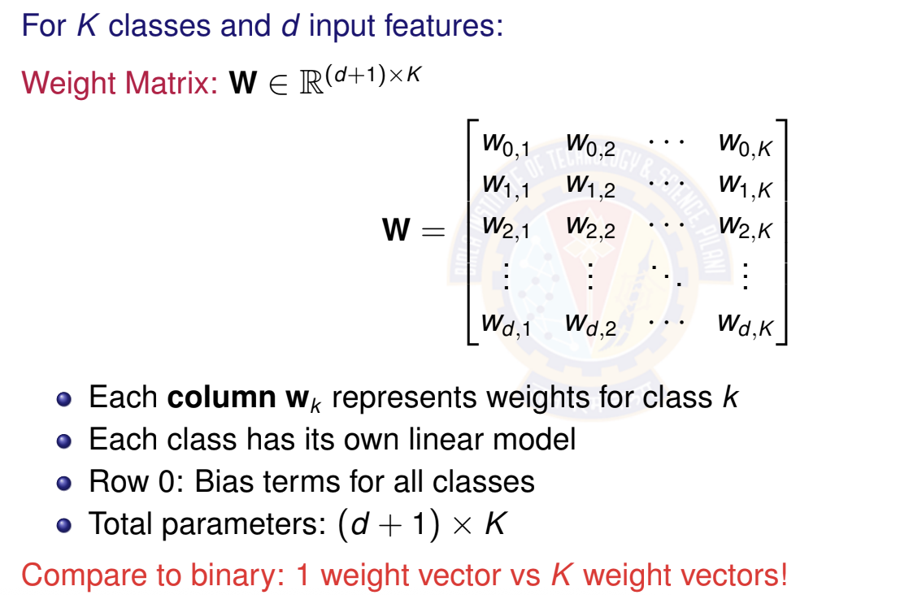
Weight Matrix for Multi-class Classification
Deep Learning

Slide 33
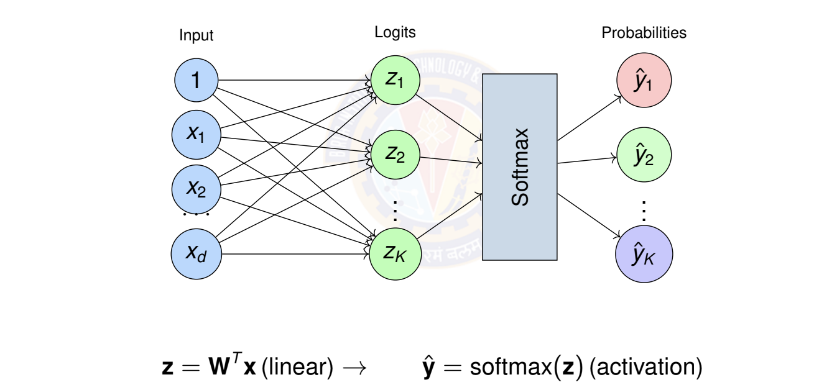
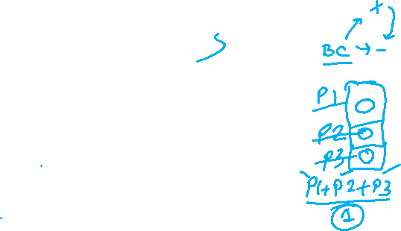
Multi-class Model Architecture
Architecture: Multiple output neurons with softmax activation
Deep Learning

Slide 34
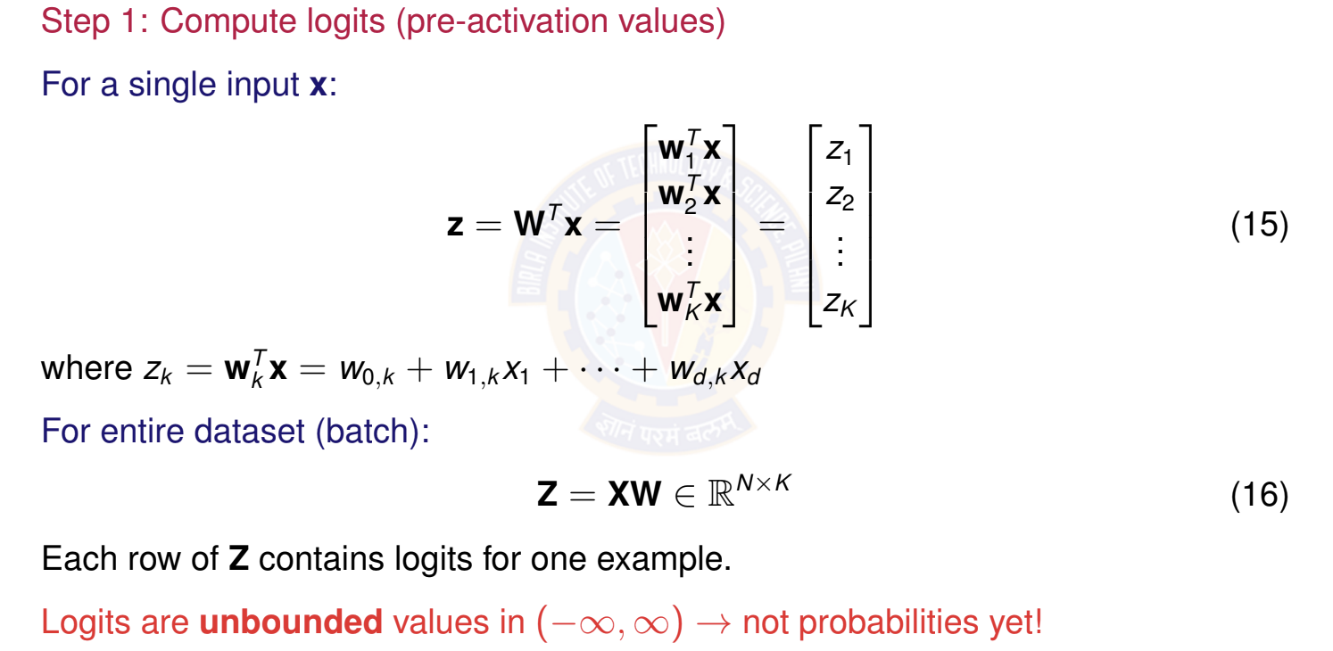

Linear Model: Computing Logits
Deep Learning

Slide 35
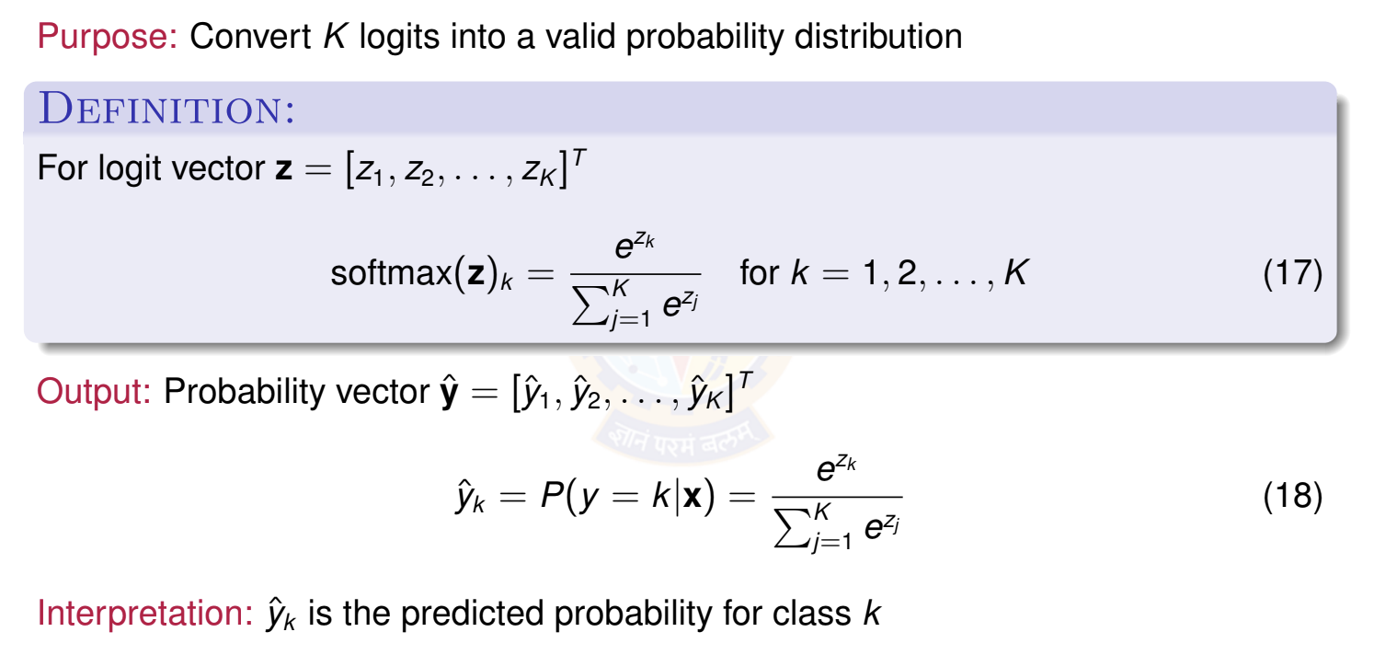
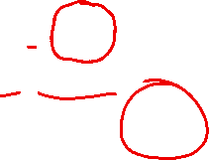
The Softmax Function
Deep Learning
57 / 100

Slide 36
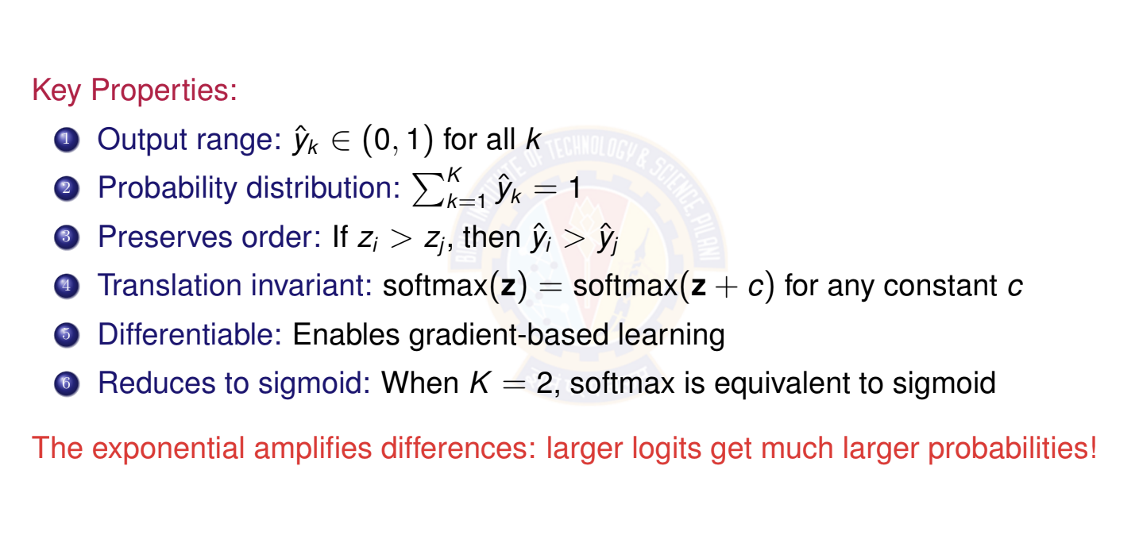
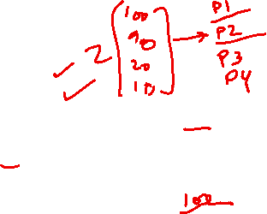
Properties of Softmax
Deep Learning

Slide 37
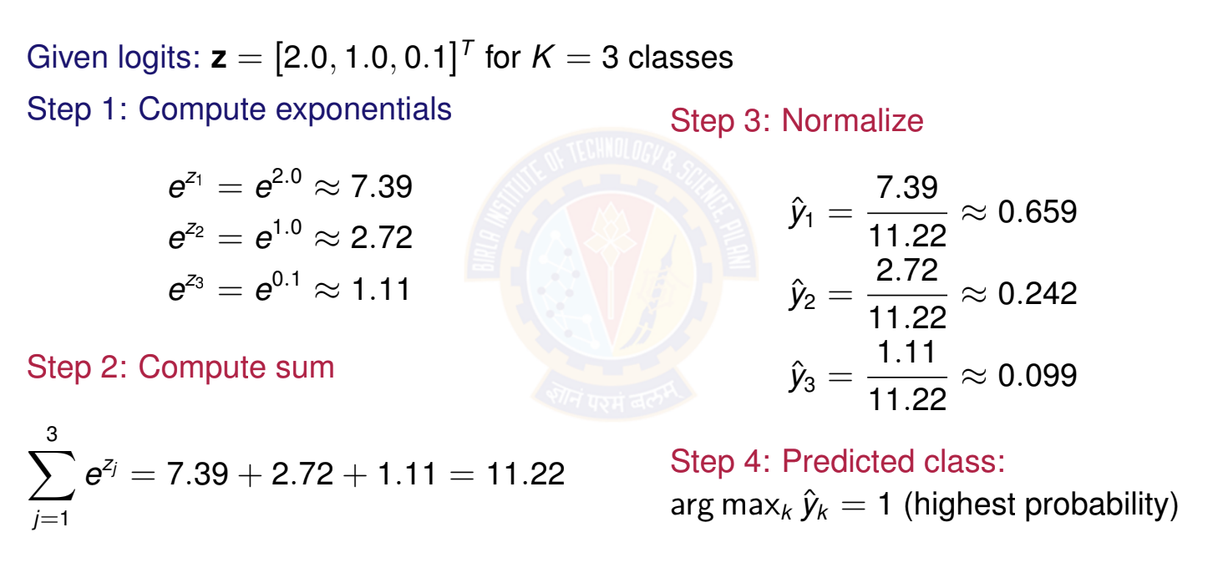
Softmax Example: Numerical Computation
Deep Learning

Slide 38
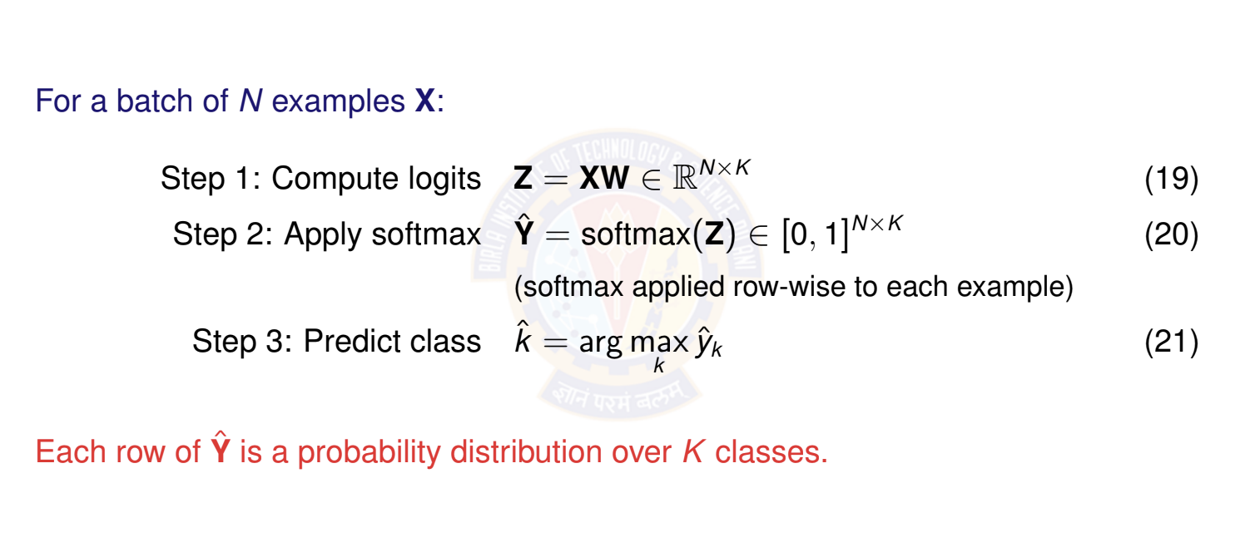
Complete Forward Pass
Deep Learning

Slide 39
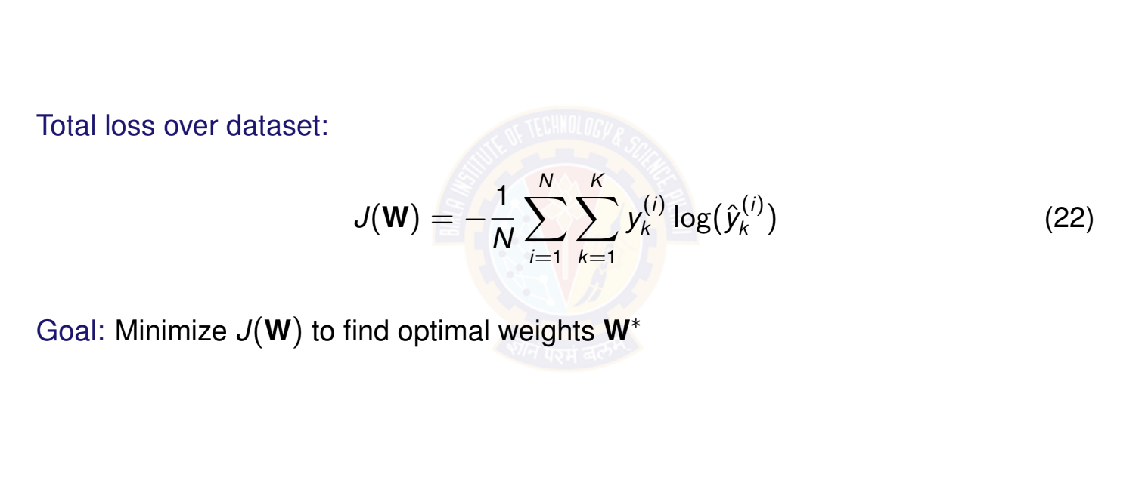
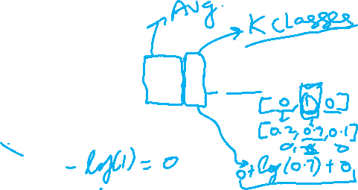
Categorical Cross-Entropy Loss
Deep Learning

Slide 40
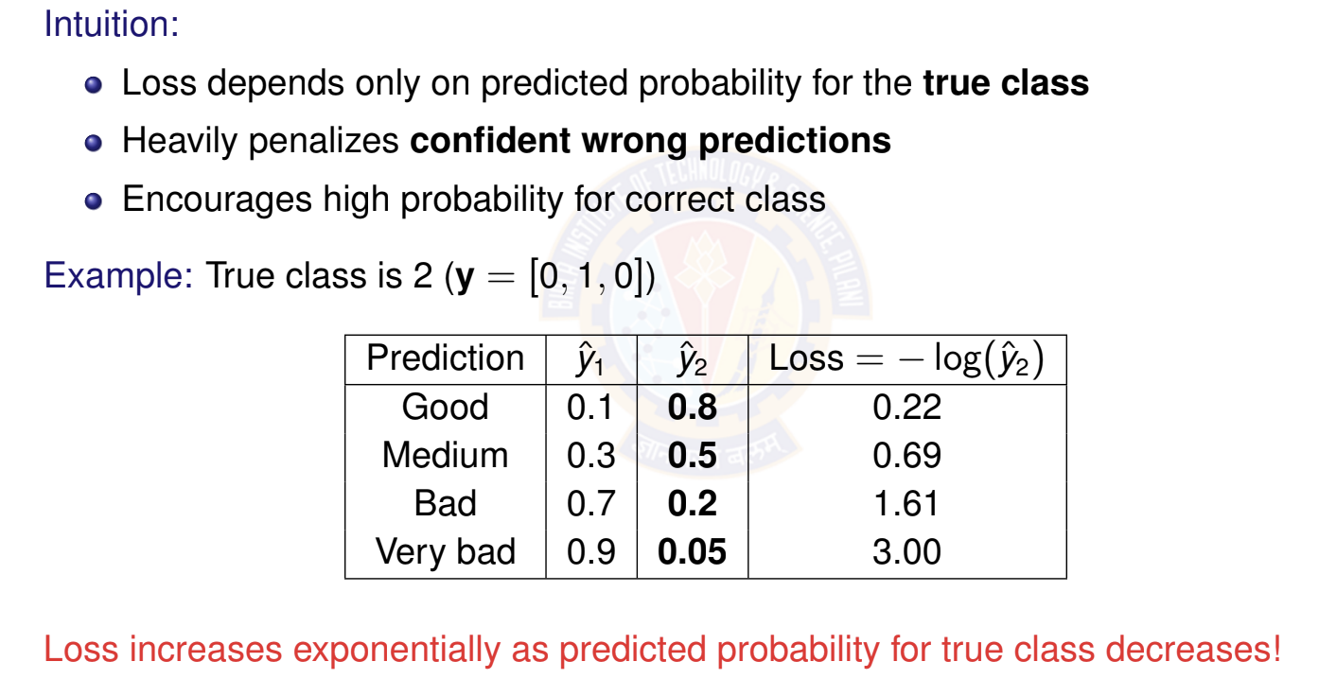

Understanding Categorical Cross-Entropy
Deep Learning

Slide 41
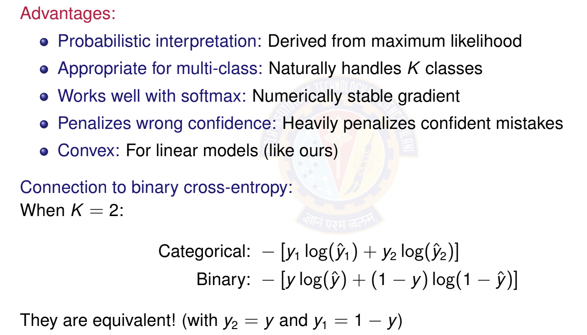
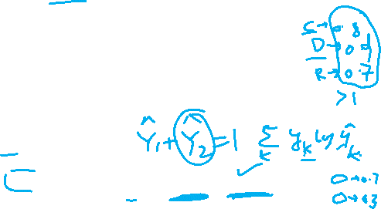
Why Categorical Cross-Entropy?
Deep Learning

Slide 42
Table of Contents
Classification
Binary Classification
Logistic Regression
The Model: Single Neuron for Binary Classification
Binary Classification: Worked Example
Binary Classification: Evaluation Metrics
Multi-class Classification
Multi-class Classification Model
Mini-batch Stochastic Gradient Descent Multiclass Classification: Worked Example Making Predictions (Inference)
Multiclass Classification: Evaluation Metrics
Implementation Tips and Debugging
1
2
3
4
5
Summary
BITS Pilani WILP
Deep Learning

Slide 43
From SGD to Mini-batch SGD
Recap: Gradient Descent Variants
Batch Gradient Descent:
Uses all N examples per update
Slow but stable, accurate gradient
Stochastic Gradient Descent (SGD):
Uses 1 random example per update
Fast but noisy, unstable
Mini-batch SGD (Best of both worlds):
Uses small batch of B examples per update (1 < B << N)
Typical batch sizes: B ∈ {32, 64, 128, 256, 512}
Good balance of speed and stability
Standard in modern deep learning!
Deep Learning
65 / 100

Slide 44
Why Mini-batch SGD?
Advantages of mini-batches:
1
Computational efficiency:
⁾ Vectorized operations (matrix multiplication)
⁾ Better GPU utilization
⁾ Faster than processing examples one-by-one
Gradient estimation:
⁾ Less noisy than single-example SGD
⁾ More stable convergence
⁾ Better approximation of true gradient
Generalization:
⁾ Noise helps escape sharp minima
⁾ Often leads to better test performance
Memory efficiency:
⁾ Can handle datasets larger than memory
⁾ Load and process data in batches
2
3
4
Deep Learning

Slide 45
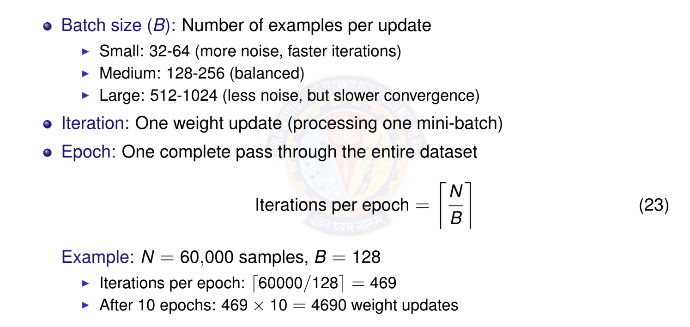
Mini-batch SGD: Key Concepts
Deep Learning

Slide 46
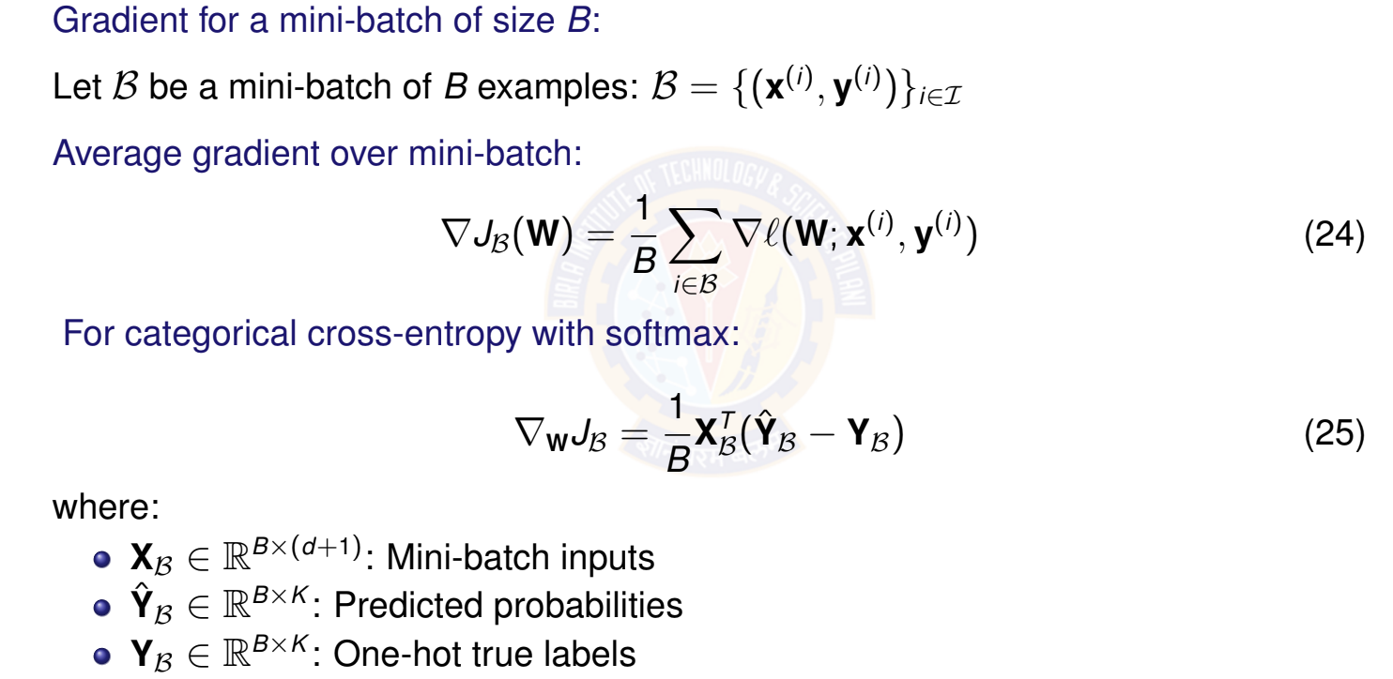
Computing Gradients for Mini-batch
Deep Learning

Slide 47
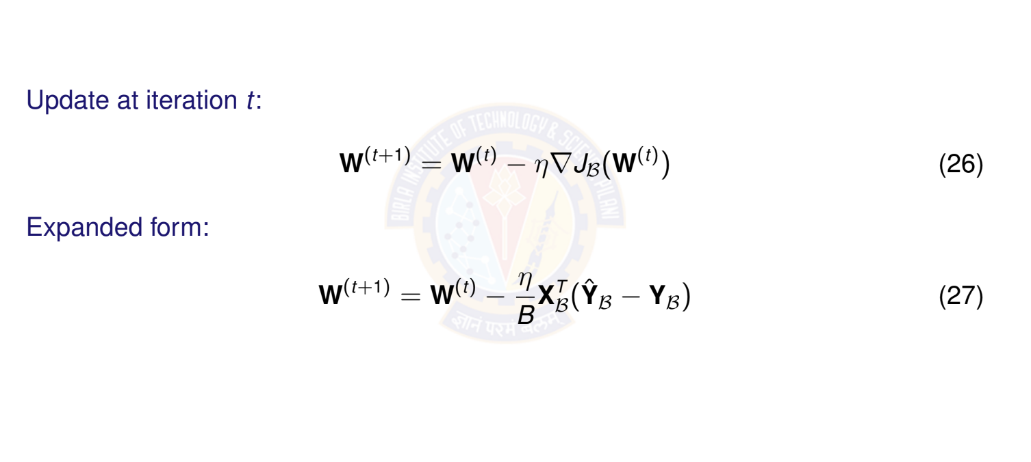
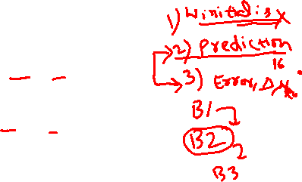
Mini-batch SGD Update Rule
Deep Learning

Slide 48
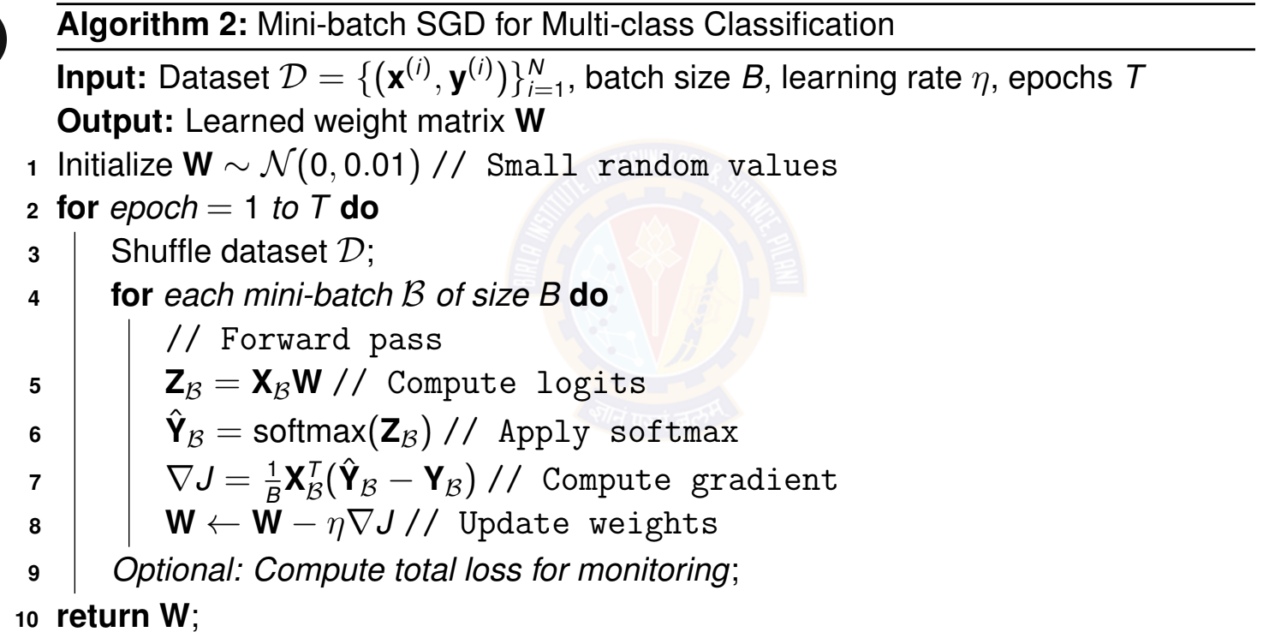

Mini-batch SGD Algorithm
Deep Learning

Slide 49

Choosing Batch Size
Batch Size | Advantages | Disadvantages
Small (32-64) | Fast iterations More updates per epoch Better generalization Escapes sharp minima | Noisy gradients Unstable training Poor GPU utilization
Medium (128-256) | Good balance Stable training Good GPU usage Standard choice | May need tuning
Large (512-1024) | Stable gradients Better GPU utilization Faster per-epoch time | Slow convergence May generalize worse More memory
Deep Learning

Slide 50
Table of Contents
Classification
Binary Classification
Logistic Regression
The Model: Single Neuron for Binary Classification
Binary Classification: Worked Example
Binary Classification: Evaluation Metrics
Multi-class Classification
Multi-class Classification Model
Mini-batch Stochastic Gradient Descent
Multiclass Classification: Worked Example
Making Predictions (Inference)
Multiclass Classification: Evaluation Metrics
Implementation Tips and Debugging
Summary
1
2
3
4
5
Deep Learning

Slide 51
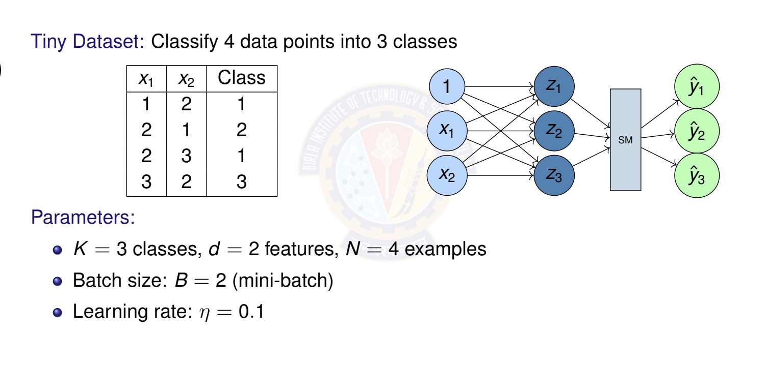
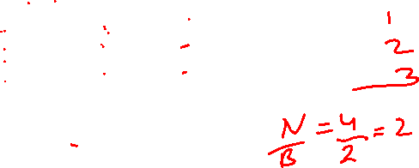
Numerical Example: Setup
Deep Learning

Slide 52
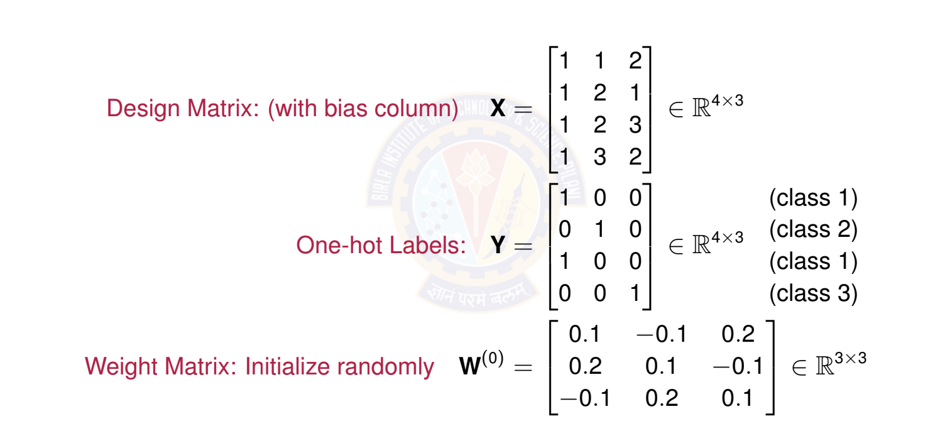

Numerical Example: Data Representation
Deep Learning

Slide 53
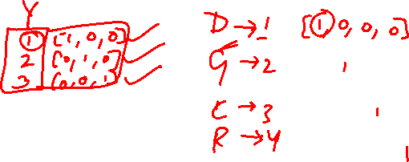

Slide 54
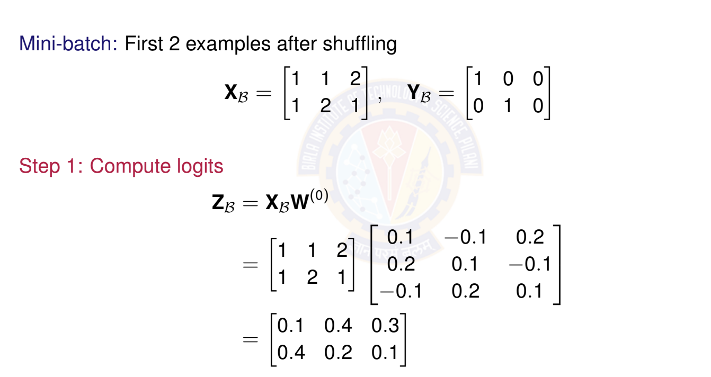

Numerical Example: First Mini-batch (Examples
Deep Learning

Slide 55
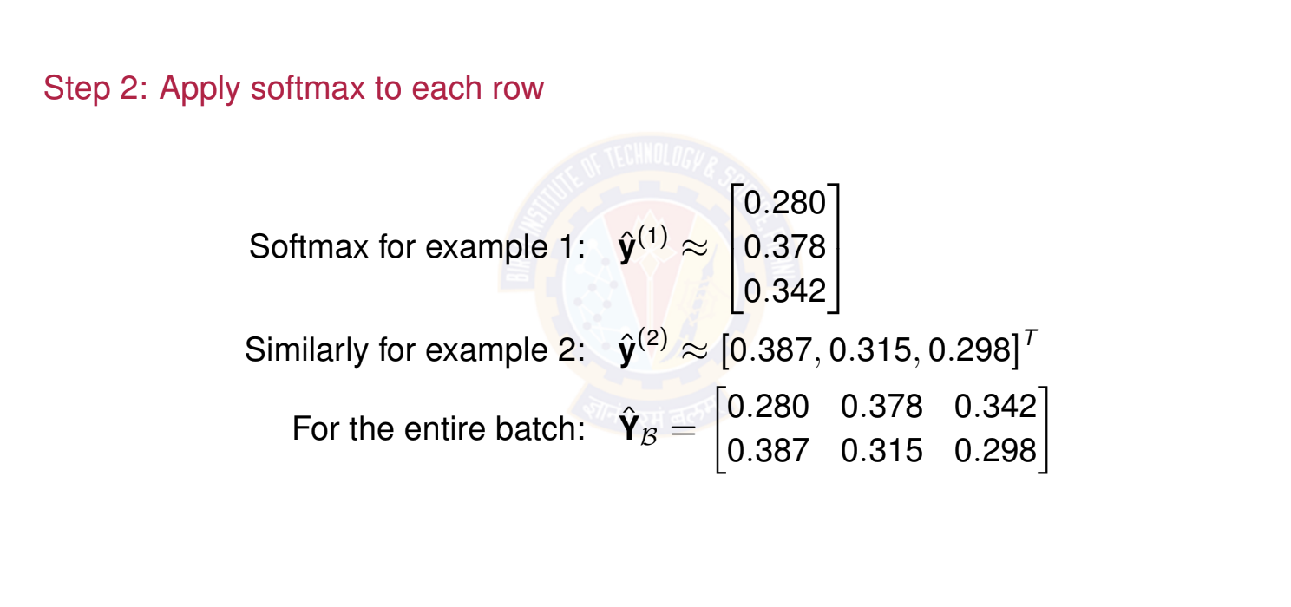

Numerical Example: Softmax Computation
Deep Learning

Slide 56
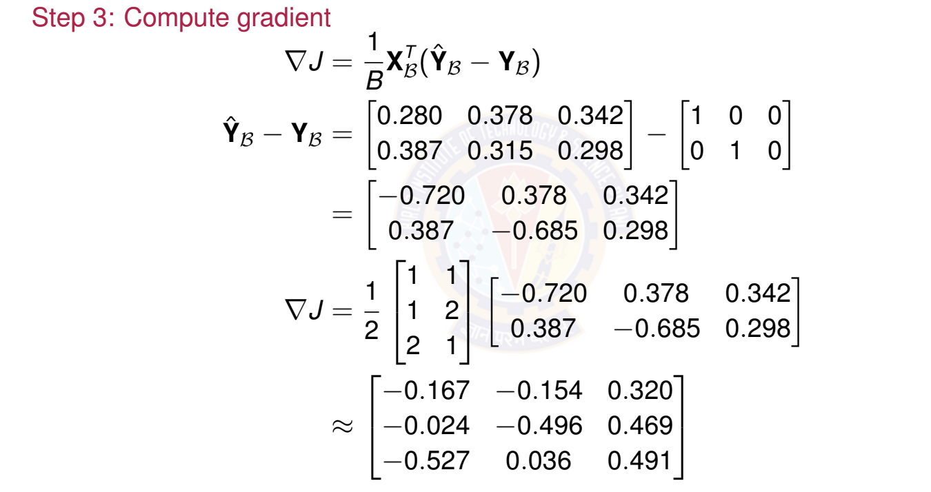

Numerical Example: Gradient and Update
Deep Learning

Slide 57
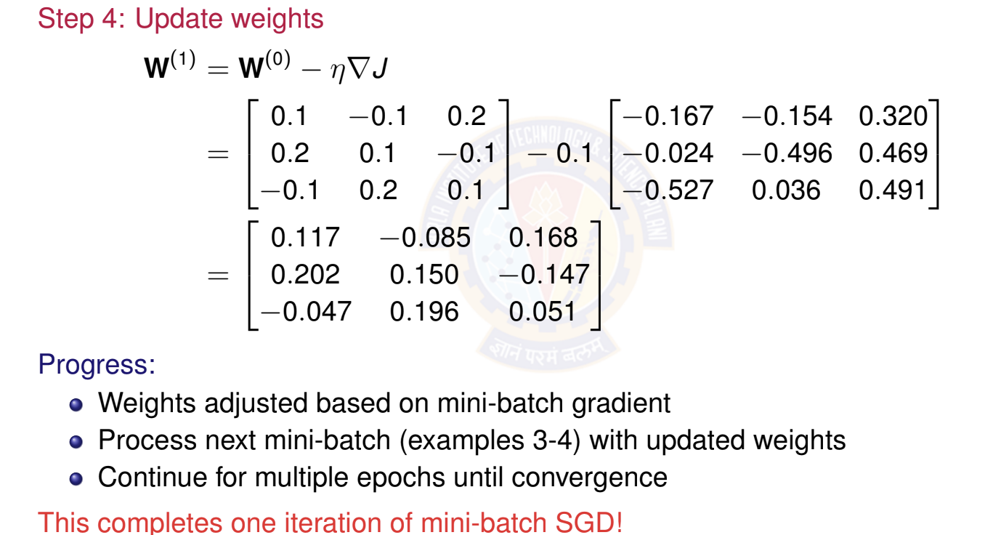
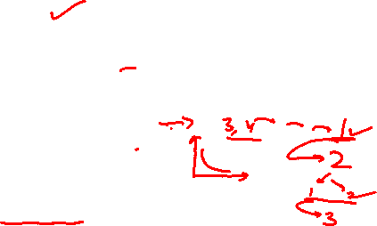
Numerical Example: Weight Update
Deep Learning

Slide 58
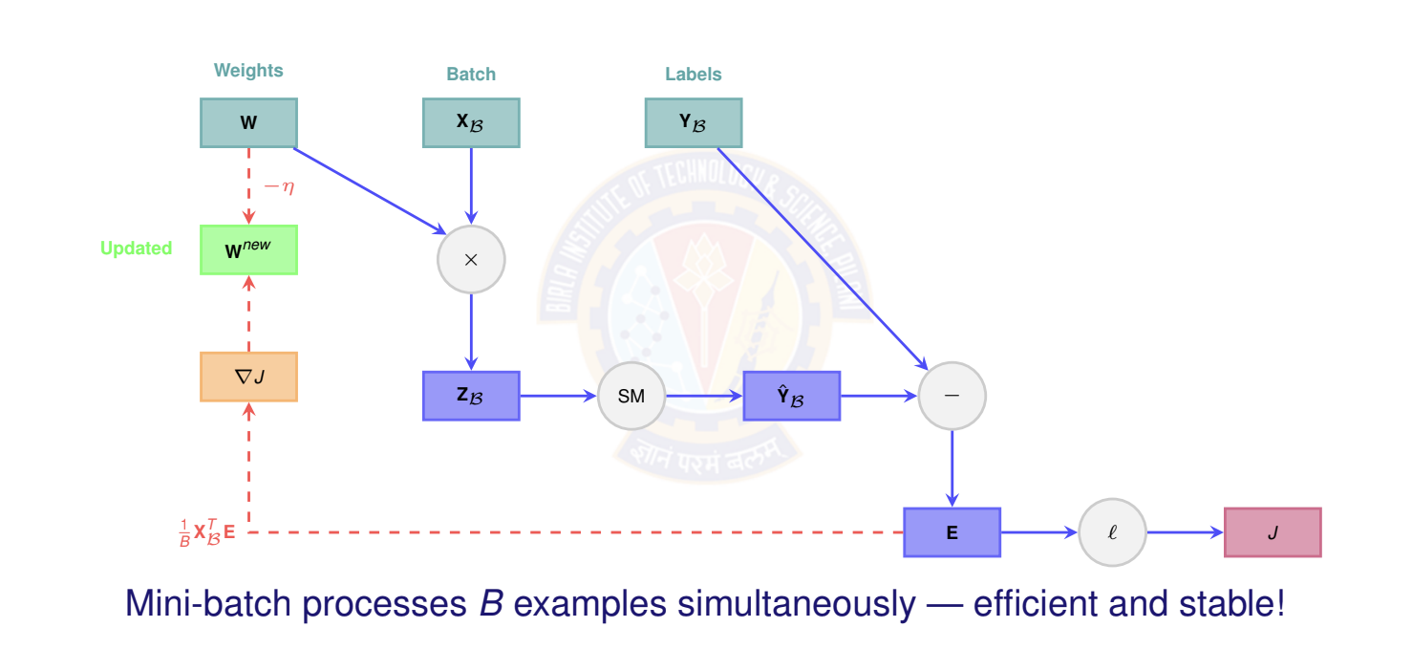

Computational Graph for Mini-batch Forward
Deep Learning

Slide 59
Table of Contents
Classification
Binary Classification
Logistic Regression
The Model: Single Neuron for Binary Classification
Binary Classification: Worked Example
Binary Classification: Evaluation Metrics
Multi-class Classification
Multi-class Classification Model
Mini-batch Stochastic Gradient Descent
Multiclass Classification: Worked Example
Making Predictions (Inference)
Multiclass Classification: Evaluation Metrics
Implementation Tips and Debugging
Summary
1
2
3
4
5
Deep Learning

Slide 60

Inference: Making Predictions
Deep Learning

Slide 61


Inference Example
Deep Learning

Slide 62
Table of Contents
Classification
Binary Classification
Logistic Regression
The Model: Single Neuron for Binary Classification
Binary Classification: Worked Example
Binary Classification: Evaluation Metrics
Multi-class Classification
Multi-class Classification Model
Mini-batch Stochastic Gradient Descent
Multiclass Classification: Worked Example
Making Predictions (Inference)
Multiclass Classification: Evaluation Metrics
Implementation Tips and Debugging
Summary
1
2
3
4
5
Deep Learning

Slide 63

Evaluation Metrics for Multi-class
Deep Learning

Slide 64

Confusion Matrix for Multi-class
Example: 3-class confusion matrix
Predicted
 | Class 1 | Class 2 | Class 3
Class 1 | 45 | 3 | 2 7
Class 2 | 5 2 | 38
Class 3 |  | 4 | 44
Actual
Interpretation:
Diagonal (green): Correct predictions (45, 38, 44) Off-diagonal (red): Misclassifications
Row sums: Total actual examples per class (50, 50, 50) Column sums: Total predicted examples per class
Accuracy: (45 + 38 + 44)/150 = 0.847 or 84.7%
Deep Learning

Slide 65
Per-class Metrics
For each class k , compute:
Precision for class k : Of all predictions for class k , what fraction were correct?
TP_{k}
Precision_{k} =
(32)
TP_{k} + FP_{k}
Recall for class k : Of all actual class k examples, what fraction did we identify?
TP_{k}
Recall_{k} =
(33)
TP_{k} + FN_{k}
F1 Score for class k :
_{= 2 ·} Precision_{k} × Recall_{k}
F 1
(34)
k
Precision_{k} + Recall_{k}
Deep Learning

Slide 66


Averaging Strategies
Deep Learning

Slide 67


Top-K Accuracy
For problems with many classes (e.g., ImageNet with 1000 classes): Top-K Accuracy: Correct if true class is in top K predictions
Example: Image classification with 1000 classes
Top-1 accuracy: Is the highest probability class correct? Top-5 accuracy: Is the true class in the top 5 predictions?
Why useful?
More forgiving metric for large K
Captures whether model has correct class among top candidates Standard in ImageNet challenge
Deep Learning

Slide 68


Summary: Multiclass Classification
Deep Learning

Slide 69
Table of Contents
Classification
Binary Classification
Logistic Regression
The Model: Single Neuron for Binary Classification
Binary Classification: Worked Example
Binary Classification: Evaluation Metrics
Multi-class Classification
Multi-class Classification Model
Mini-batch Stochastic Gradient Descent
Multiclass Classification: Worked Example
Making Predictions (Inference)
Multiclass Classification: Evaluation Metrics
Implementation Tips and Debugging
Summary
1
2
3
4
5
Deep Learning

Slide 70


Implementation Tips
Deep Learning

Slide 71


Debugging Checklist
Deep Learning

Slide 72
Table of Contents
Classification
Binary Classification
Logistic Regression
The Model: Single Neuron for Binary Classification
Binary Classification: Worked Example
Binary Classification: Evaluation Metrics
Multi-class Classification
Multi-class Classification Model
Mini-batch Stochastic Gradient Descent
Multiclass Classification: Worked Example
Making Predictions (Inference)
Multiclass Classification: Evaluation Metrics
Implementation Tips and Debugging
Summary
1
2
3
4
5
Deep Learning

Slide 73


Activation Functions
Deep Learning

Slide 74


Loss Functions
Deep Learning

Slide 75


Gradient Descent Variants
Deep Learning

Slide 76


Comparison of Linear models
Deep Learning

Slide 77
Recap: Binary Classification
Logistic Regression
Key insight: Sigmoid maps linear combination to probability; optimized by minimiz- ing cross-entropy loss.
Problem: Classify into two classes: y ∈ {0, 1} Model: Single neuron with sigmoid activation Output: Probability y^{ˆ} = P(y = 1|x) ∈ [0, 1] Loss: Binary cross-entropy
Training: Stochastic Gradient Descent (SGD)
x₁
Σ
z
σ
y^{ˆ}
x₂
Class 0 or 1
Deep Learning

Slide 78

Recap: Multi-class Classification
Deep Learning
78 / 100

Slide 79

References
Zhang, A., Lipton, Z. C., Li, M., & Smola, A. J. (2023). Dive into Deep Learning. Cambridge University Press. Chapter 4 (Linear Neural Networks for Classification). https://d2l.ai/
Goodfellow, I., Bengio, Y., & Courville, A. (2016). Deep Learning. MIT Press. Chapter 6 (Deep Feedforward Networks). https://www.deeplearningbook.org/
Bishop, C. M. (2006). Pattern Recognition and Machine Learning. Springer. Chapter 4 (Linear Models for Classification).
Murphy, K. P. (2022). Probabilistic Machine Learning: An Introduction. MIT Press. Chapter 10 (Logistic Regression). https://probml.github.io/pml-book/
Deep Learning

